Slide 1

Gold Price Forecasting Model
A predictive model for forecasting gold prices for the next 30 days

Slide 2

Project Objective
Data provided is related to gold prices. The objective is to understand the underlying structure in your dataset and come up with a suitable forecasting model which can effectively forecast gold prices for next 30 days.
This forecast model will be used by gold exporting and gold importing companies to understand the metal price movements and accordingly set their revenue expectations.

Slide 3

Dataset Summary
Dataset contains 2182 rows with two columns data and price.
Data: Historical gold prices, recorded daily.
Key Attributes: Date and gold price.
Data Span: Covers a significant period (e.g., years) for forecasting.
Cleaning: No Missing values
Observed Trends: Seasonal patterns and long-term trends identified in price movements.

Slide 4
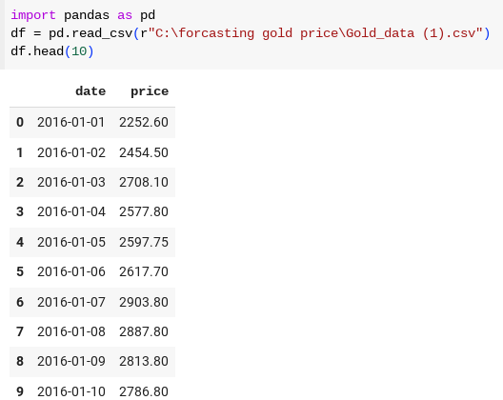
Dataset:

Slide 5
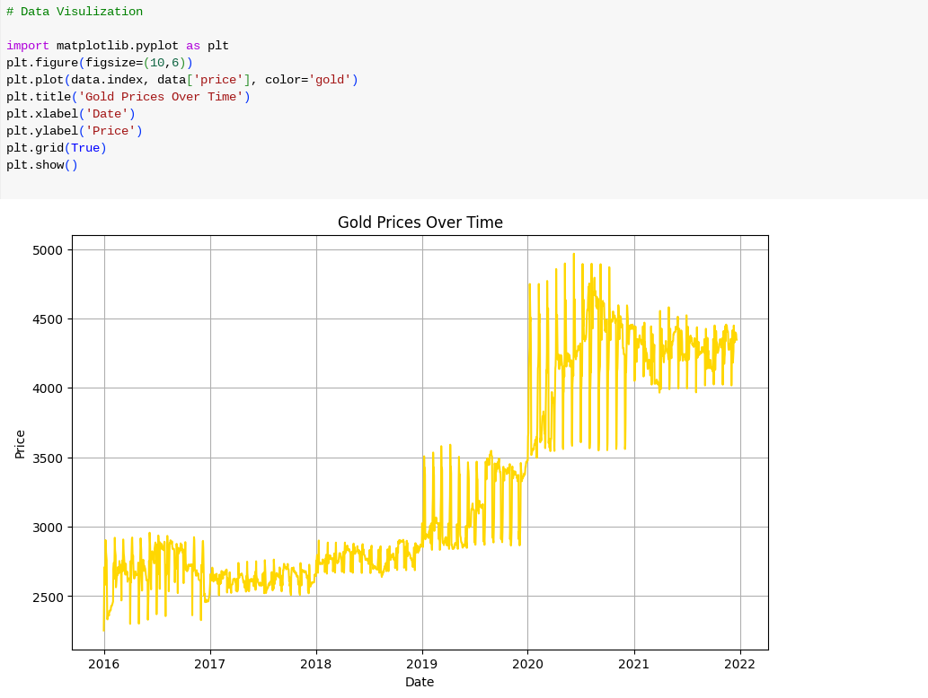
VISUALISATIONS:

Slide 6
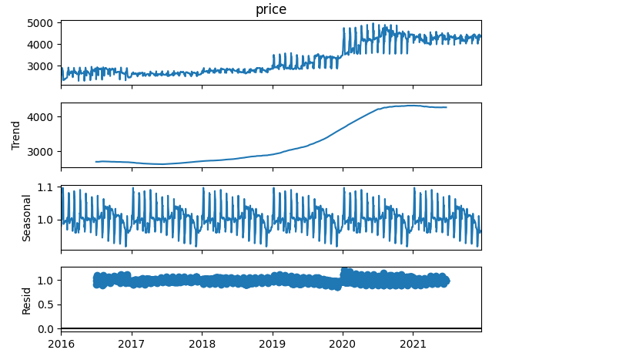

Slide 7
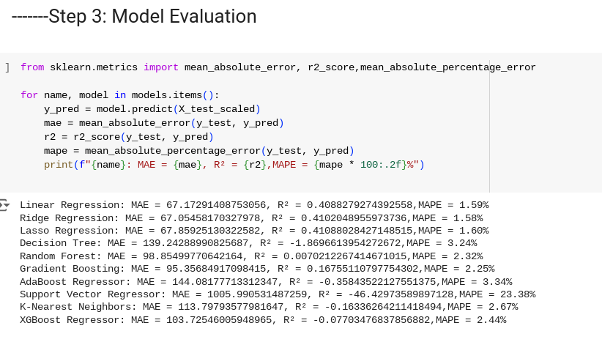
Model evaluation:

Slide 8
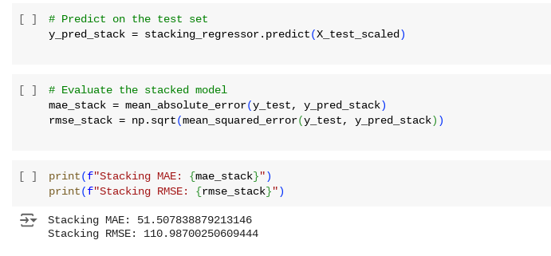

Slide 9
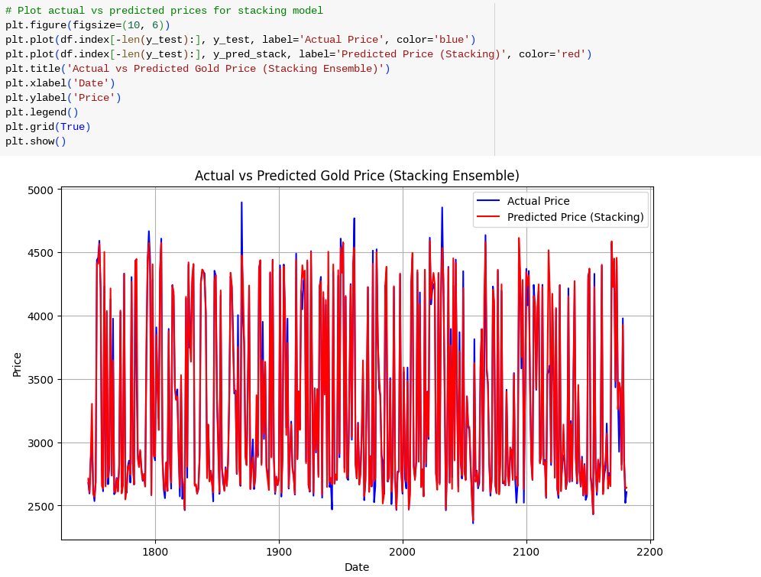
Model building:

Slide 10
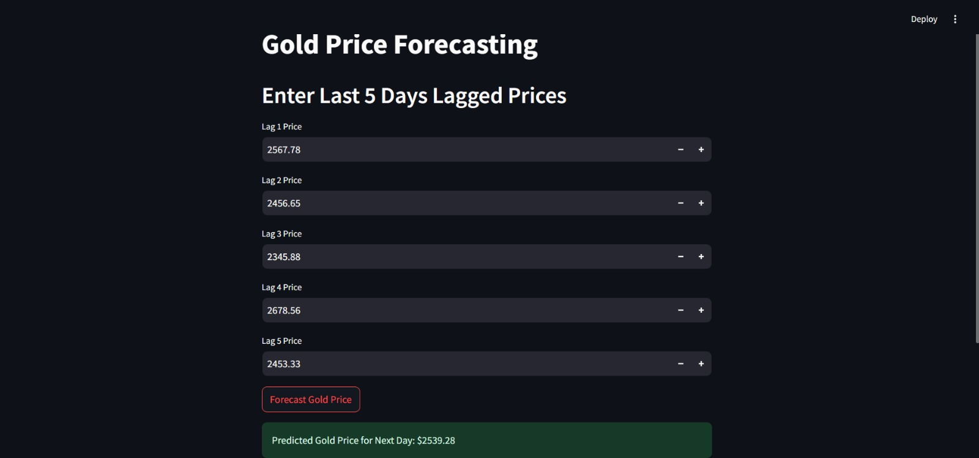
Deployment:

Slide 11
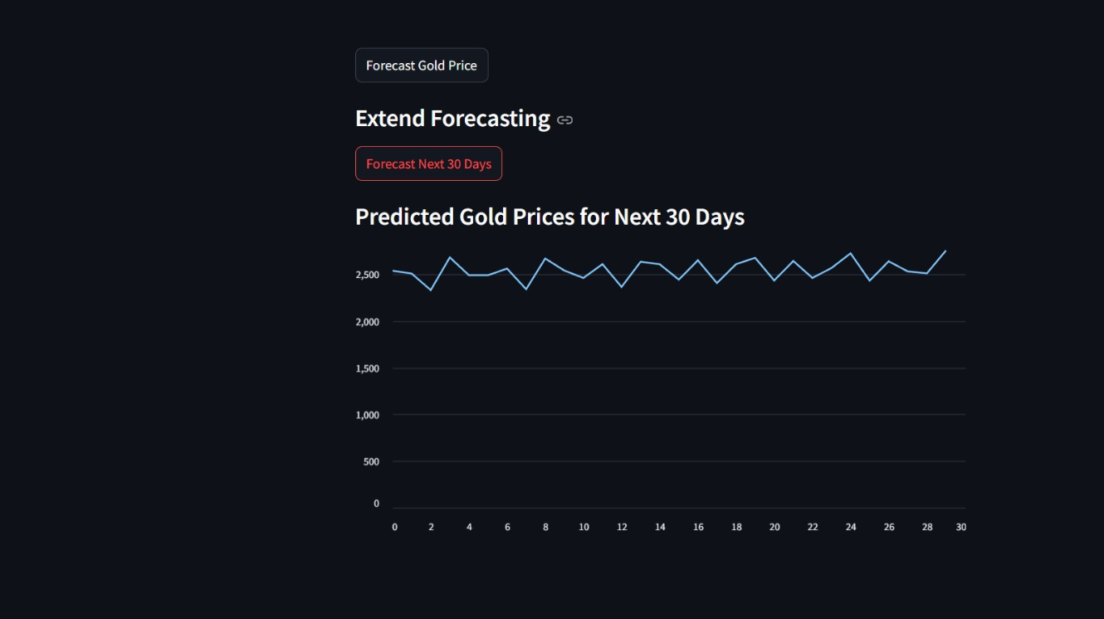

Slide 12
Challenges faced:
Data Collection:
Availability of Data: Getting consistent historical data on gold prices and any relevant external factors (like currency rates) can be challenging.
2. Data Preprocessing:
Normalization/Scaling: Ensuring the dataset is scaled correctly, especially if combining features with different units or ranges.
Feature Engineering: Selecting or engineering relevant features, such as lagged prices or moving averages, to capture gold price trends effectively.
3. Model Selection:
Choosing the Right Model: Forecasting models like ARIMA, LSTM, and Random Forest each have unique strengths. Selecting the most accurate model requires testing .
4. Deployment:
Real-Time Forecasting Needs: Ensuring the model can handle updates and deliver real-time insights.

Slide 13
THANK YOU

